Slide 1
Using Social-Emotional Learning Strategies in the College Classroom to Create a Climate of Caring, Belonging, and Mattering
(What Higher Education Can Learn
from K12 Education)
Dr. Susan N. Kushner Benson
University of Akron

Slide 2
Part 1: The Teaching-Learning Process
The Teaching-Learning Process
Identify Learning Objectives
Create learning activities and
opportunities to review and practice
(formative assessment)
Assess mastery of learning objectives
(summative assessment)
Emphasis on mastery of pedagogical content knowledge
Evaluate fidelity of teaching and learning
Reteach as needed
Notes:
This is a traditional model of the teaching and learning process in p-16 education.

Slide 3
Part 1: Teaching as a Helping Profession
Subject Matter Mastery
Skill development
Teaching as Helping Profession
Importance of Building Relationships
Notes:
The focus on subject matter mastery and skill development is not being questioned, but as educators we must understand that the foundation of the teaching and learning process is an the recognition of teaching as a helping profession and the critical role of relationship building.

Slide 4
Part 1: Teaching as a Helping Profession
What are helping professions?
American Psychological Association: Occupations that provide health and education services to individuals and groups, including occupations in the fields of psychology, psychiatry, counseling, medicine, nursing, social work, physical and occupational therapy, teaching, and education.
What are characteristics of helping professionals?
Professionally committed
Trustworthy and dependable
Effective communicator (verbal and non-verbal)
Active Listener
Skilled a building rapport
Empathetic
Advocate
Patient
Culturally competent
Embracing the role of helping professional, leads to..

Slide 5
Part 1: Teaching as a Helping Profession
Why is it imperative that - as educators - we change our mindsets?
I care about you as a
student and as an
individual. Your success and well-being matter to me.
Its not my job.
Notes:
Susie will end this slide by making a statement about the mental health challenges and sense of well being among college students and faculty and segue to to Natacha .

Slide 6
Part 1: Teaching as a Helping Profession
Promoting, Developing, and Valuing Positive Relationships
Research on “Caring” in Higher Education
A powerful teaching tool
Verbal immediacy - using humor, calling on students by
name, asking students how they feel about an assignment,
engaging in conversations about topics that students bring
up in class, etc.
Physical immediacy - smiling, making eye contact, moving around the room during instruction
Positive impact on attitudes toward learning, academic achievement, attendance, increased study time, and additional course enrollment in the discipline.
College graduates had double the chances of being engaged in their work and were three times as likely to be thriving in their well-being if they connected with a professor on the campus who stimulated them, cared about them, and encouraged their hopes and dreams.
Notes:
This slide is underdevelopment.

Slide 7
Part 1: Teaching as a Helping Profession
Promoting, Developing, and Valuing Positive Relationships
Research on “Mattering” in Higher Education
The feeling of being significant and important to other people.
Mattering is essential to our well-being and the well-being of our students.
Students and faculty who feel like they matter will be highly engaged both inside and outside the classroom.
Relationships faculty have with students and classes are the essential driver of teaching and learning.
Professors must demonstrate to their students that they care about them as individuals and ensure that students understand and participate as collaborators in the learning process.
Notes:
This slide is underdevelopment.

Slide 8
Part 2: The Emerging Adult
Notes:
Susie will end this slide by making a statement about the mental health challenges and sense of well being among college students and faculty and segue to to Natacha .

Slide 9
Part 2: The Emerging Adult
Emerging Adults – Ages 18 to 25
A time of instability and self-focus.
Who am I? Who are all of these people out there? How do I fit in?
Feelings of being in-between adolescence and adulthood.
Parts of the brain that control rational thinking, good judgement, and awareness of long-term consequences are not fully developed.
Lives in flux as they explore life and love while trying to find meaningful work and a sense of purpose.
Notes:
Susie will end this slide by making a statement about the mental health challenges and sense of well being among college students and faculty and segue to to Natacha .

Slide 10
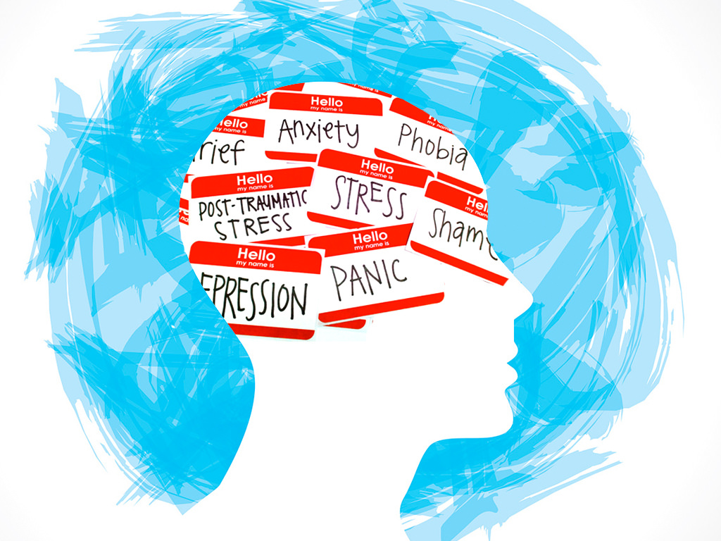
Part 2: The Emerging Adult
Mental Health Challenges Facing College Students
College students are experiencing all-time high rates of depression, anxiety and suicidality.
In 2022, 77% of college students experienced moderate to serious psychological distress with 35% of students diagnosed with anxiety and 27% with depression.*
Mental health problems are predictive of lower academic success
Students diagnosed with depression are at twice the risk of dropping out or stopping out
What can faculty do to create an inclusive classroom that promotes student success?
* Healthy Minds Survey. https://healthymindsnetwork.org/hms/
Notes:
Susie will end this slide by making a statement about the mental health challenges and sense of well being among college students and faculty and segue to to Natacha .

Slide 11
Part 3: Practicing What We Preach: Integrating SEL in the College Classroom
Yoder’s Framework of
Instructional and Social Teaching Practices*
*Yoder, N. (2014). Teaching the Whole Child Instructional Practices That Support Social-Emotional Learning in Three Teacher Evaluation Frameworks. Center on Great Teachers & Leaders at the American Institutes for Research. https://gtlcenter.org/sites/default/files/TeachingtheWholeChild.pdf
*Kushner Benson, S. N. (2023). Beyond content and pedagogy: The importance of social-emotional learning in higher education. In Exploring Social Emotional Learning in Diverse Academic Settings, IGI Global Publishing.
Notes:
Susie will end this slide by making a statement about the mental health challenges and sense of well being among college students and faculty and segue to to Natacha .

Slide 12
Part 3: Practicing What We Preach: Integrating SEL in the College Classroom
Social Teaching Practices |  | CASEL SEL Competency
Classroom Management | Policies and procedures related to classroom conduct such as attendance, using cellphone in class, assignment due dates are implemented because they are promotive of student learning rather than punitive in nature. | Self-Awareness Social Awareness Sefl-Management Responsible Decision-Making
Teacher Language | Verbal, written, and non-verbal communication that fosters motivation and achievement and conveys a sense of caring and mattering. | Social Awareness Relationship Skills
Student Voice | The opinions and perspectives of students is both sought and valued, and students are given the opportunity to contribute to decisions that impact their learning. | Self-Awareness Social Awareness Relationship Skills
Classroom Climate | The college classroom is characterized by positive interactions, warmth, and support. Students perceive that faculty care about their students and that they matter. | Self-Awareness Social Awareness Relationship Skills
Notes:
Susie will end this slide by making a statement about the mental health challenges and sense of well being among college students and faculty and segue to to Natacha .

Slide 13
Part 3: Practicing What We Preach: Integrating SEL in the College Classroom
Instructional Teaching Practices |  | CASEL SEL Competency
Cooperative Learning | Students work in small collaborative instructional groups which promote interpersonal and small group skills. | Self-Awareness Social Awareness Relationship Skills
Classroom Discussions | Students engage in vibrant and active discussions that promote the acknowledgment and extension of diverse thinking. | Self-Awareness Social Awareness Relationship Skills
Self-Regulated Learning | Students set personal goals, reflect and monitor their progress toward attaining their goals, making adjustments to the goal setting and attainment process. | Sefl-Management Responsible Decision-Making
Active Learning | Students are actively engaged in the learning process in classroom contexts which promote complex and higher order learning, rather than passive participants. | Self-Awareness Social Awareness Self-Management
Academic Press and Expectations | Students engage in meaningful and rigorous work in a classroom that is characterized by high expectations. | Self-awareness Responsible Decision-Making
Notes:
Susie will end this slide by making a statement about the mental health challenges and sense of well being among college students and faculty and segue to to Natacha .

Slide 14
Part 3: Practicing What We Preach: Integrating SEL in the College Classroom
Issues associated with classroom management in the college classroom:
Missing or arriving late to class
Sleeping or eating in class
Texting or using cellphones during class
Talking inappropriately during class
Power struggles
Cheating or plagiarizing
Consider reframing your mindset
Be proactive rather than punitive.
Notes:
Susie will end this slide by making a statement about the mental health challenges and sense of well being among college students and faculty and segue to to Natacha .

Slide 15
Part 3: Practicing What We Preach: Integrating SEL in the College Classroom
Belief Statement: Semester grades should reflect her students’ achievement of the learning objectives that are the foundation of the course, not students’ ability to manage their schedules.
Explains to students (and include in syllabus) that attendance is taken to track student patterns and provide data to enhance ability to support student success.
For example, if a student does poorly on an assignment or an exam, use attendance data to help explain low performance.
Reach out to students to ensure that the student and/or the student’s family are not experiencing some kind of ‘real life’ emergency.
Notes:
Susie will end this slide by making a statement about the mental health challenges and sense of well being among college students and faculty and segue to to Natacha .

Slide 16
Part 3: Practicing What We Preach: Integrating SEL in the College Classroom
Belief Statement: Emergencies happen which might impact student’s ability to submit an assignment by the specific date list on the syllabus. Grades on assignments should reflect mastery of student learning objectives not students’ ability to manage their schedules.
Recognize that students are frequently balancing due dates for 3 or more other classes, work, and family obligations.
Admit that you are not likely to be able to grade all assignments the day they are due and that late assignments merely go to the “bottom of the pile”.
Reach out to students to ensure that the student and/or the student’s family are not experiencing some kind of ‘real life’ emergency.
Clearly articulate policies on the syllabus. For example: Assignments that are submitted more than a week late will be graded and returned at your convenience and may be returned with minimal or no feedback.
Notes:
Susie will end this slide by making a statement about the mental health challenges and sense of well being among college students and faculty and segue to to Natacha .

Slide 17
Part 3: Practicing What We Preach: Integrating SEL in the College Classroom
Belief Statement: Cell phone and laptops may have a legitimate purpose in class.
Recognize that students may be parents and caregivers and may need to receive important and/or emergency text or phone call. Clearly articulate policies on the syllabus. For example, be unobtrusive in checking a text message and/or reply quickly. Otherwise, step out of classroom so as not to distract other students.
Explain to students at the start of the class session if the class session will or will not require the use of their laptops and ask them to close their screens when relevant.
Notes:
Susie will end this slide by making a statement about the mental health challenges and sense of well being among college students and faculty and segue to to Natacha .

Slide 18
OCTEO 2023 Conference Survey Instructional Practices that Promote Students' Academic and Social-Emotional Success The intent of this survey is to learn about the academic and social-emotional instructional practices you use in your classes to support your students' success. We will create a guidebook from the responses we receive and share this with conference attendees.

